Slide 1
Naïve Bayes Classifier

Slide 2



Naïve Bayes Classifier- Introduction
Naïve Bayes classifier is a probabilistic classifier that uses Bayes theorem and Naïve assumption to classify test examples using the training examples.
According to Bayes Theorem,
where P(A|B) is called posterior probability of A given B; P(A) is the prior probability of A; P(B|A)is the likelihood of B given A; and P(B) is the evidence of B.
For machine learning tasks; A is the target variable ( and B is the input test case
i
1 2 3 4 k
Therefore we find,
P y_{i} P(K|y_{i})
P(K)
i
i

Slide 3




Naïve Bayes Classifier- Introduction (Contd….)
Since P(X) is constant w.r.t different values of _{i}. Hence it can be ignored.
Therefore,
i i i
According to Naïve assumption, the probability of each feature in the input is conditionally independent of each other.
Therefore,
k
i i j=1 j i
The final predicted label (y*) for a given input X is thus computed as:
n
y * = arg max P ( y _{i} ) P ( x _{j} | y _{i} )
y
j =1

Slide 4
Training Phase of Naïve Baye Classifier
In the training phase of Naïve Bayes Classifier, we compute prior probability and likelihood probabilities from the training data.
Computing Class Prior Probabilities
Class prior probability of each unique value y_{i} of the output variable Y is computed as:
𝑛𝑢𝑚𝑏𝑒𝑟 𝑜𝑓 𝑡𝑟𝑎𝑖𝑛𝑖𝑛𝑔 𝑒𝑥𝑎𝑚𝑝𝑙𝑒𝑠 𝑙𝑎𝑏𝑒𝑙𝑒𝑑 𝑎𝑠 𝑦_{i} 𝑛_{yi}
⁼ 𝑡𝑜𝑡𝑎𝑙 𝑡𝑟𝑎𝑖𝑛𝑖𝑛𝑔 𝑒𝑥𝑎𝑚𝑝𝑙𝑒𝑠 ⁼ 𝑁
𝑃 𝑦
i

Slide 5


Training Phase of Naïve Baye Classifier (Contd…)
Computing Likelihoods
The likelihood of each unique value of each feature given each class label is computed as follows:
𝑃 𝑥_{j} = 𝑐 𝑦_{i} =
𝑛𝑢𝑚𝑏𝑒𝑟 𝑜𝑓 𝑡𝑟𝑎𝑖𝑛𝑖𝑛𝑔 𝑒𝑥𝑎𝑚𝑝𝑙𝑒𝑠 𝑓𝑜𝑟 𝑤ℎ𝑖𝑐ℎ 𝑓𝑒𝑎𝑡𝑢𝑟𝑒 𝑥_{j} ℎ𝑎𝑠 𝑣𝑎𝑙𝑢𝑒 𝑐 𝑎𝑛𝑑 𝑙𝑎𝑏𝑒𝑙𝑒𝑑 𝑎𝑠 𝑦𝑖 ^{𝑛}x_{j}=c,y_{i}
=
𝑡𝑜𝑡𝑎𝑙 𝑛𝑢𝑚𝑏𝑒𝑟 𝑜𝑓 𝑡𝑟𝑎𝑖𝑛𝑖𝑛𝑔 𝑒𝑥𝑎𝑚𝑝𝑙𝑒𝑠 𝑙𝑎𝑏𝑒𝑙𝑒𝑑 𝑎𝑠 𝑦𝑖 𝑛
y_{i}
For all, 𝑥_{j}∈ 𝑋 𝑓𝑒𝑎𝑡𝑢𝑟𝑒 𝑠𝑒𝑡 , 𝑐 ∈ 𝑢𝑛𝑖𝑞𝑢𝑒 𝑣𝑎𝑙𝑢𝑒𝑠 𝑜𝑓𝑥_{j}, and
i

Slide 6

Testing Phase of Naïve Bayes Classifier
In the test phase, for each test example X_test=x₁x₂x₃…….x_{k} , probability of each class label given the test example is computed as:
k
i test i j i
j=1
The final predicted label (y*) for a given input X is thus computed as:
n
y * = arg max P ( y _{i} ) P ( x _{j} | y _{i} )
y
j =1

Slide 7
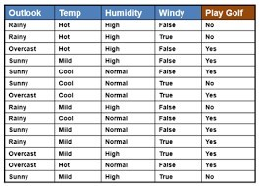
Numerical Example-I
Consider the following training set, that classify the output variable play golf as
Yes or No conditions Temperature, Status.
depending upon weather such as Outlook,
Humidity, and Wind
Using Naïve Bayes Classifier, classify that whether on a Rainy, Cool, High Humidity, and Windy day we can play golf or not.

Slide 8


Example 1-Solution
Training Phase:
Computing Class Prior Probability
For each unique value of output variable Play Golf i.e., Yes or No, the prior probability is computed as follows:
number of training examples labelled yes 9 total training examples 14
number of training examples labelled no 5 total training examples 14

Slide 9
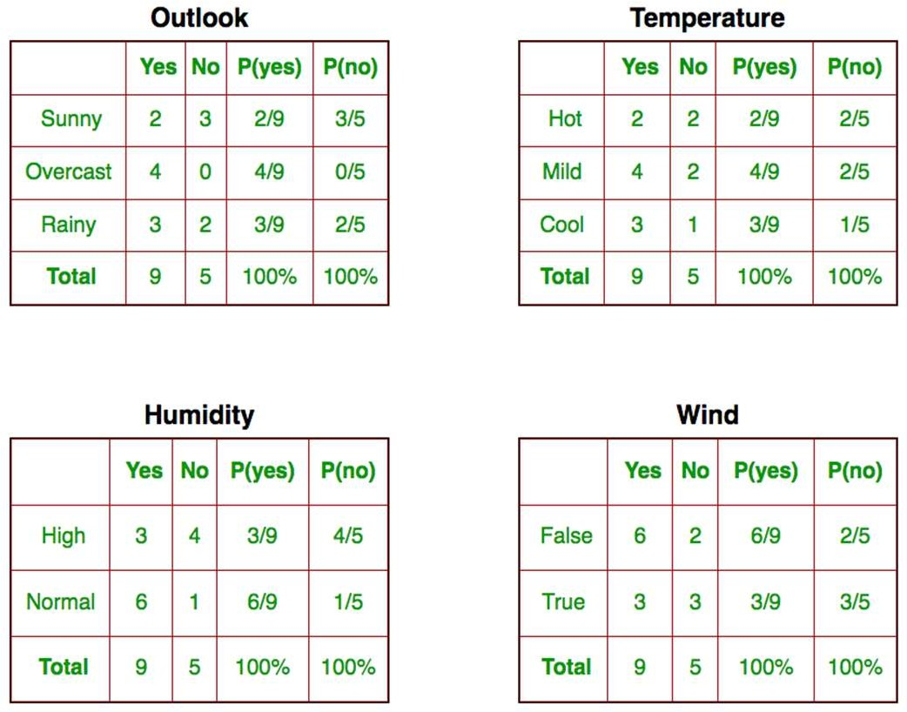
Example 1-Solution (Contd….)
Computing Likelihoods
The likelihood of each unique value of each feature given each class label is computed.
For instance, for the feature outlook, unique values are Rainy, Overlook, and Sunny.
Therefore, P(Outlook=Rainy|Yes), P(Outlook=Rainy|No), P(Outlook=Overlook|Yes), P(Outlook=Overlook|No), P(Outlook=Sunny|Yes), P(Outlook=Sunny|No) are computed. The same is repeated for all features as shown in figure).

Slide 10
Example 1-Solution (Contd….)
Test Example: Outlook=Rainy, Temperature=Cool, Humidity=High, and Windy =True
𝑃(𝑝𝑙𝑎𝑦_{golf} = 𝑦𝑒𝑠|Outlook=Rainy, Temperature=Cool, Humidity=High, and Windy =True)
= 𝑃 𝑦𝑒𝑠 × 𝑃(Outlook=Rainy|yes) × 𝑃(Temperature=Cool|yes) × 𝑃(Humidity=High|yes) × 𝑃(Windy=True|yes)
9 2 3 3 3 486
= × × × × =
= 𝟎. 𝟎𝟎5291
14 9 9 9 9 91854
𝑃(𝑝𝑙𝑎𝑦_{golf} = 𝑛𝑜|Outlook=Rainy, Temperature=Cool, Humidity=High, and Windy =True)
= 𝑃 𝑛𝑜 × 𝑃(Outlook=Rainy|no) × 𝑃(Temperature=Cool|no) × 𝑃(Humidity=High|no) × 𝑃(Windy=True|no)
5 |  | 3 |  | 1 |  | 4 |  | 3 180
14 |  | 5 |  | 5 |  | 5 |  | 5 8750
= 𝟎. 02057
Therefore, the given test example should be labeled as Play Golf = No

Slide 11
Advantages of Naïve Bayes Classifier
It is simple and easy to understand.
No hyper-parameter tuning is required.
It is scalable i.e. if a new instance is added it is easy to adjust class prior and likelihood probabilities.
It can be used for real time classifications.
It is very suitable for multi-class classification (as we need not to apply techniques like one vs. rest to fit multiple binary classifiers).

Slide 12
Naïve Bayes Classifier- Problems
Problem I: Zero Frequency Problem
If an individual feature value for a particular class label is missing, then the frequency-based probability estimate will be zero. And we will get a zero when all the probabilities are multiplied. This problem is called zero frequency problem.
For example, in the figure (shown in slide 9), the P(outlook=Overcast | no)
=0 because there is no training example which has overcast outlook for label
no.
To handle this zero frequency problem, we apply smoothing technique.

Slide 13
Naïve Bayes Classifier- Problems (Contd..)
Problem I: Zero Frequency Problem (Solution)
Smoothing is a technique that handles the problem of zero probability in Naïve Bayes.
In smoothing, while computing likelihood of any feature given label, we add a parameter α in numerator and α X number of features in denominator i.e.,
𝑃 𝑥_{j} = 𝑐 𝑦_{i} = _{𝑛}
^{𝑛}x_{j}=c,y_{i} ^{+ 𝛼}
y_{i}
+ 𝛼 × 𝑘
Where k is the number of features. 𝛼 is added so that probability is never 0 and 𝛼 × 𝑘 is added in denominator so that probability is never greater than 1.
When 𝛼 = 1, it is called Laplace Smoothing (correction) and if 𝛼 < 1, it is called Lidstone Smoothing.
𝛼 should not be taken greater than 1 because it will give higher probability mass to zero frequency counts.

Slide 14
Naïve Bayes Classifier- Problems (Contd..)
Problem II: Independence Assumption
Naïve Bayes Classifier, is based on the Naïve assumption, that the features are independent of each other.
But in real case scenarios, input features are not always independent.
For instance, if we have to label a person as adult or child on the basis of height and weight of person, then features height and weight are not independent of each other.
In order to handle this problem, we must apply dimensionality reduction if the features are corelated.
Due to the Naïve assumption, this classifier is most suitable for Text Classification as the words are features in text and these words can be considered independent for classification.

Slide 15
Naïve Bayes Classifier- Problems (Contd..)
Problem III: Numerical Underflow
We know, likelihood probability is computed as:
k
𝑃 𝑦_{i} 𝑋 ∝ 𝑃(𝑦_{i}) G 𝑃(𝑥_{j}|𝑦_{i})
j=1
If k (number of features are large). Then the product is very small and approximate to zero. This problem is called numerical underflow.
In order to solve this problem, we compute log likelihoods (so as to convert product to sum).
k
+ Σ log(𝑃(𝑥_{j}|𝑦_{i}))
j=1
log 𝑃 𝑦_{i} 𝑋
∝ log 𝑃 𝑦_{i}

Slide 16
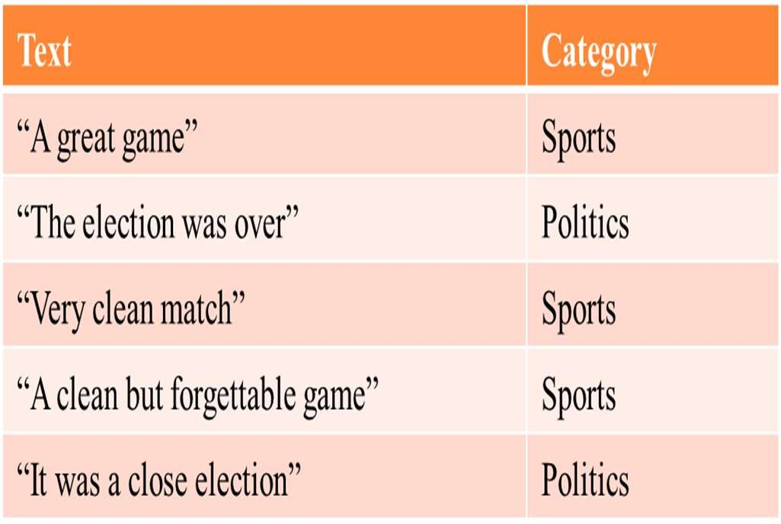
Numerical Example II: Text Classification
Consider the training dataset (shown in figure), where in each training document is labeled as Sports or Politics category.
Using Naïve Bayes Classifier, classify the document ‘A very close game ’
(Pre-processing: Convert lower case, no stopword removal, no stemming).

Slide 17
Example 2: Solution
Training Phase
Computing Prior Probability
₌ number of documents labeled as 'Sports' ₌ 3 total number of docuemnts 5
₌ number of documents labeled as 'Politics' ₌ 2 total number of docuemnts 5
𝑃 𝑆𝑝𝑜𝑟𝑡𝑠
𝑃 𝑃𝑜𝑙𝑖𝑡𝑖𝑐𝑠
Computing Likelihood Probabilities:
Number of features (words) = 14 = |V|
{a, great, game, the, election, was, over, very, clean, match, but, forgettable, it, close}

Slide 18
Example 2: Solution (Contd…)
Probability of each feature (word) given Sports Label
Document Feature | D1 | D3 | D4 | Frequency | Probability(word/Sports)
a | 1 | 0 | 1 | 2 | 2+1/11+14=0.12
great | 1 | 0 | 0 | 1 | 1+1/11+14=0.08
game | 1 | 0 | 1 | 2 | 2+1/11+14=0.12
the | 0 | 0 | 0 | 0 | 0+1/11+14=0.04
election | 0 | 0 | 0 | 0 | 0+1/11+14=0.04
was | 0 | 0 | 0 | 0 | 0+1/11+14=0.04
over | 0 | 0 | 0 | 0 | 0+1/11+14=0.04
very | 0 | 1 | 0 | 1 | 1+1/11+14=0.08
clean | 0 | 1 | 1 | 2 | 2+1/11+14=0.12
match | 0 | 1 | 1 | 2 | 2+1/11+14=0.12
but | 0 | 0 | 1 | 1 | 1+1/11+14=0.08
forgettable | 0 | 0 | 1 | 1 | 1+1/11+14=0.08
it | 0 | 0 | 0 | 0 | 0+1/11+14=0.04
close | 0 | 0 | 0 | 0 | 0+1/11+14=0.04
Total |  |  |  | 11

Slide 19
Example 2: Solution (Contd…)
Probability of each feature (word) given Politics Label
Document Feature | D2 | D5 | Frequency | Probability(word/Politics)
a | 0 | 1 | 1 | 1+1/9+14=0.09
great | 0 | 0 | 0 | 0+1/9+14=0.04
game | 0 | 0 | 0 | 0+1/9+14=0.04
the | 1 | 0 | 1 | 1+1/9+14=0.09
election | 1 | 1 | 2 | 2+1/9+14=0.13
was | 1 | 1 | 2 | 2+1/9+14=0.13
over | 1 | 0 | 1 | 1+1/9+14=0.09
very | 0 | 0 | 0 | 0+1/9+14=0.04
clean | 0 | 0 | 0 | 0+1/9+14=0.04
match | 0 | 0 | 0 | 0+1/9+14=0.04
but | 0 | 0 | 0 | 0+1/9+14=0.04
forgettable | 0 | 0 | 0 | 0+1/9+14=0.04
it | 0 | 1 | 1 | 1+1/9+14=0.09
close | 0 | 1 | 1 | 1+1/9+14=0.09
Total |  |  | 9

Slide 20
Example 2: Solution (Contd…)
Testing Phase
Test Sentence= X = a very close game
P(Sports|X)= P(S)  P(a|Sports)  P(very|Sports)  P(close|Sports)  P(game|Sports)
= 0.6  0.12  0.08  0.04  0.12
= 2.7610⁻⁵
P(P|X)= P(Politcs)  P(a|Politcs)  P(very|Politics)  P(close|Politics)  P(game|Politics)
=0.4  0.09  0.04  0.09  0.04
= 5.1810⁻⁶
Since P(Sports|X) > P(Politics|X)
Therefore, the test sentence can be labeled as Sports

Slide 21
Variants of Naïve Bayes Classifier
Naïve Bayes Classifier has following variants:
Multinomial Naïve Bayes Classifier
Bernoulli Naïve Bayes Classifier
Gaussian Naïve Bayes Classifier

Slide 22
Multinomial Naïve Bayes Classifier
The naive Bayes algorithm for multinomially distributed data is called Multinomial Naïve Bayes Classifier.
The multinomial distribution is a probability distribution used in experiments with two or more variables.
The multinomial Naive Bayes classifier is suitable for classification with discrete features (e.g., word counts for text classification). The multinomial distribution normally requires integer feature counts. However, in practice, fractional counts such as tf-idf may also work.
The probability P(x_{j}=c y_{i}) of feature j appearing in a sample belonging to class y_{i} is computed as follows in multinomial classifier:
^{n}x_{j}=c,y_{i}^{+α}
j i
n_{yi}+α ×k

Slide 23
Bernoulli Naïve Bayes Classifier
The naive Bayes training and classification algorithms for data that is distributed according to multivariate Bernoulli distributions.
There may be multiple features but each one is assumed to be a binary-valued (Bernoulli, boolean) variable.
Therefore, this class requires samples to be represented as binary-valued feature vectors.

Slide 24
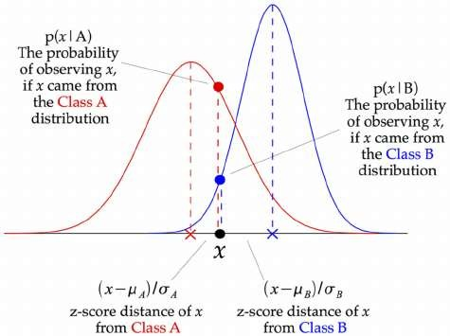
Gaussian Naïve Bayes Classifier
In case the feature variable are continuous, then it is not possible to compute likelihood of each feature value given label for continuous range.
The version of Naïve Bayes algorithm that deal with continuous feature values is called Gaussian Naïve Bayes Classifier.
In Gaussian Naive Bayes, continuous values associated with each feature are assumed to be distributed according to a Gaussian distribution.
So, we make use of z-score for observing each feature value given a label.

Slide 25
Gaussian Naïve Bayes Classifier (contd…)
In particular, Probability of observing any feature value c for feature x_{j} given a class label y_{i} is computed as:
2
–1
2
x_{j},y_{i}
j
i
2
x_{j},y_{i}
x_{j},y_{i}
Where _{xj,yi} denote mean of x_{j} feature values labeled as y_{i} and _{xj,yi} is standard deviation of x_{j} feature values labeled as y_{i}.

Slide 26
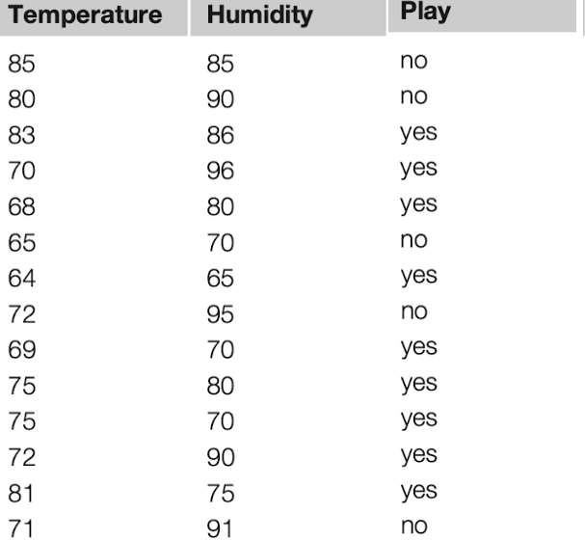
Numerical Example - 3
Consider the following training set, that classify the output variable play golf as Yes or No depending upon weather conditions such as Temperature, Humidity (same as example 1 but the features are continuous instead of categorical).
Using Gaussian Naïve Bayes Classifier, classify that whether on a day when temperature is 66 and humidity is 90 is we can play golf or not.

Slide 27
Example 3: Solution
Training Phase:
Computing Class Prior Probability
For each unique value of output variable Play Golf i.e., Yes or No, the prior probability is computed as follows:
𝑃 𝑝𝑙𝑎𝑦 𝑔𝑜𝑙𝑓 = 𝑦𝑒𝑠
₌ number of training examples labelled yes ₌ 9 total training examples 14
₌ number of training examples labelled no ₌ 5 total training examples 14
𝑃 𝑝𝑙𝑎𝑦 𝑔𝑜𝑙𝑓 = 𝑛𝑜

Slide 28
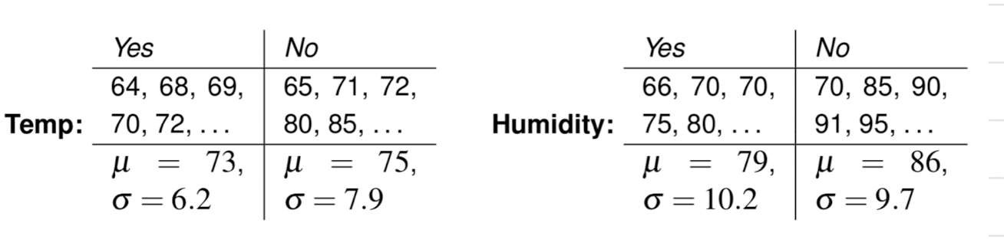
Example 3: Solution (Contd…)

Slide 29



Example 3: Solution (Contd…)
Testing Phase:
Test Example: T=66,H=90
1
—1
2
66–73
2
2π×6.2
1
—1
2
6.2
66–7
2
2π×7.9
1
—1
2
7.9
90–79
2
2π×10.2
1
—1
2
10.2
90–86
2
2π×9.7 9.7
9
14
𝑃 𝑦𝑒𝑠 𝑇 = 66, 𝐻 = 90 = 𝑃 𝑦𝑒𝑠 𝑃 𝑇 = 66 𝑦𝑒𝑠 𝑃 𝐻 = 90 𝑦𝑒𝑠 =
× 0.034 × 0.0221 = 0.00048
5
𝑃 𝑛𝑜 𝑇 = 66, 𝐻 = 90 = 𝑃 𝑛𝑜 𝑃 𝑇 = 66 𝑛𝑜 𝑃 𝐻 = 90 𝑛𝑜 = × 0.0279 × 0.0381 = 0.00037
14
Therefore, on given temperature and humidity, we can play golf

